Slide 1
Design and Functions of CAVO (Computer Adaptive Vocabulary Assessment) CAVO 的设计与功能
Minru Li 李敏儒
National East Asian Languages resource Center
The ohio state university
2022年6月10日

Slide 2
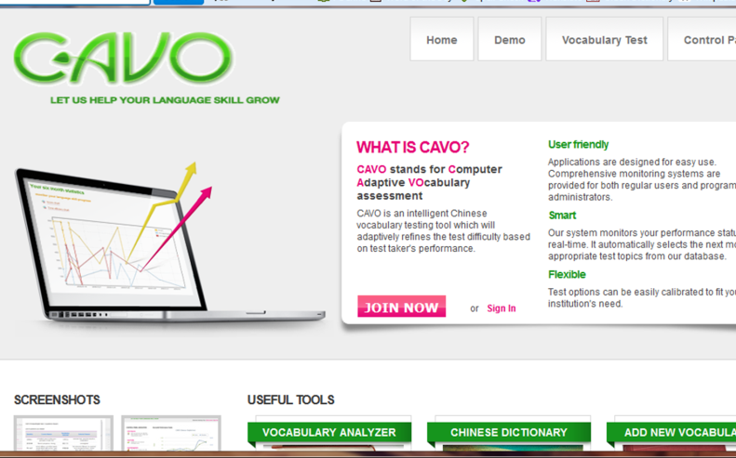
Notes:
CAVO stands for Computer Adaptive Vocabulary Test. In the field of teaching Chinese as foreign language, there are several types of online tests. One is comprehensive test like HSK. Another one is reading test like Computer-Adaptive Test for Reading Chinese. The third type is listening comprehension test like Chinese Computer Adaptive Listening Comprehension Test. Different from the above tests, CAVO focuses on recognition of Chinese vocabulary.
It is an intelligent Chinese vocabulary testing tool to assist learners in building and assessing vocabulary knowledge. In the test, it can adaptively refine the test difficulty level based on test taker's performance. It is a ubiquitous, transparent and low-stakes test. Let’s see some features of the test.

Slide 3
有关CAVO
设计者： 吴伟克（Galal Walker)
技术人员： 刘军、熊晖，陈寒凝
历史：2005年开始设计，2008年上线
目的：提供老师与学习者一个低风险评估工具，通过自主学习，加强对词汇的阅读与理解

Slide 4
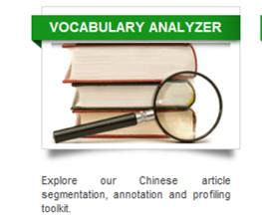
无需注册就可以用的工具
Chinese Vocabulary Frequency Analyzer
Chinese Dictionary search
Demo
1）中文词汇频率分析
2）中文词典
3）词汇测试示范
Notes:
there are three tools which can be readily accessed by users without registration.
Chinese Vocabulary Frequency Analyzer
Chinese Dictionary search
Demo test

Slide 5
词频分析
Notes:
Using Chinese Vocabulary Frequency Analyzer, a user needs to select a Chinese text and pastes it into the text box. This tool can perform automatic Chinese sentence segmentation, keyword annotation as well as keyword frequency profiling. The more frequent the words are in the text; the larger the characters are in the analyzer.
Moreover, when your cursor hovers over a marked word, the pinyin, interpretation of meaning in both Chinese and English, will appear in a pop-up window to help you understand the word.

Slide 6
中文词典
http://cavo.osu.edu
Notes:
Chinese Dictionary search.
First, one should select one type of dictionary among the two options: CAVO Test Dictionary
CAVO test dictionary contains more than 20,000 Chinese vocabulary.
CAVO Comprehensive Dictionary
CAVO comprehensive dictionary contains more than 155,000 Chinese vocabulary.
Exact search
You can set the desired minimum and/or maximum number of characters in a phrase to help you narrow down the number of returned entries.
Fuzzy search:
For example, if you want to find out all the usages of a single Chinese word '百', you can specify the min to 1 and max. number of characters to 15, and then enter search term '百,' it will return all Chinese character or phrases containing the search term in any position of the phrase.
It is a handy Chinese dictionary to enhance your experience in learning Chinese vocabulary.

Slide 7
测试示范
http://cavo.osu.edu
Notes:
As an unregistered user, you can only take the demo test. There are three tests, pinyin, Chinese-English, and Chinese-Chinese. However, in the demo, there are only five questions and the test won’t be recorded.

Slide 8
注册用户（学生），可以有两种选择： 1）电脑自适应词汇测试 2）老师自定义词汇测试
Chinese-Pinyin Test
Chinese-English Test
Chinese-Chinese Test
Custom Test
四种类型：
中文—拼音
中文—英文
中文—中文
自定义测试
Notes:
For the registered learners, they can take standard tests and custom tests designed by their instructors anywhere they can access the Internet.
Each of the following tests contains 4 difficulty levels. The test will start with easiest level then move to higher levels based on test performance. During the test, the full range of difficulties will be utilized to score your language proficiency. Your final score will be calculated based on both the time taken and the accuracy of your responses.
There are 30 questions in each CAVO standard test.
http://cavo.nealrc.org/

Slide 9
注册了的老师，可以设计自定义测试
http://cavo.osu.edu/
Notes:
Account needs to be activated by system admin. (This requirement is waived during the promotional period)
For the registered instructors, they can design custom tests from anywhere in the Internet.
http://cavo.nealrc.org/
To demo on how to design a custom test.

Slide 10
学生考试后发证书

Slide 11
应试者马上可以看到考试结果及正误分析
http://cavo.osu.edu/
Notes:
Show the record of a test.
The correct answers and wrong answers are recorded and displayed.

Slide 12
学习者可以看到自己的历次考试结果：
Notes:
Transparent:
The results of the tests are available to the learners.
Show the record of a test taker.
This examinee took two tests and his scores are 666 and 694 respectively. The highest score is 800.

Slide 13
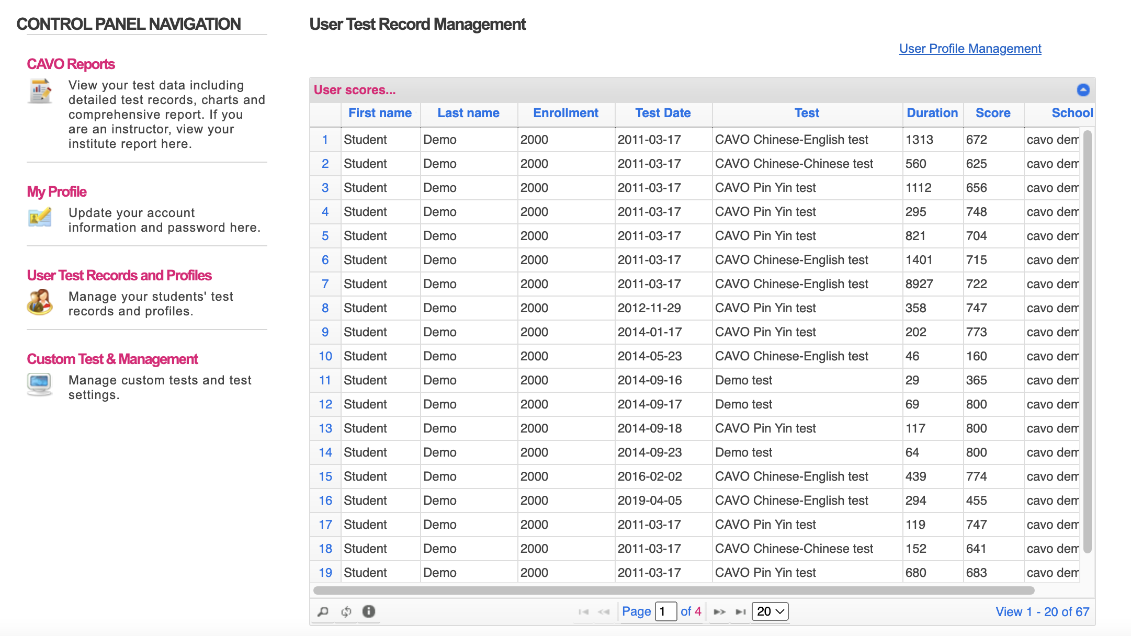
老师可以看到学生的成绩
Notes:
The instructor has access to the students’ records of assessment in his/her program.

Slide 14
老师有管理修订自己的学生信息的权限
Notes:
The instructor can manage and edit learners’ profiles within his/her program.

Slide 15
老师也有管理及修改自己的自定义测试信息的权限
Notes:
The instructor can manage and edit the information of the custom tests.
Demo on how to edit the information of a custom test.

Slide 16
CAVO大致用途
1）可以用来做词汇分析
2）在学期中或学期末，老师可以方便用自定义测试，对学习者进行形成性评估

Slide 17
谢谢！ 请提宝贵意见
李敏儒
li.28@osu.edu

